Slide 1
Internship Presentation
A presentation on content management system
Presented by
Satish shanker Dongol
Exam roll no.: 2504/09
Tu registration no.: 7-2-551-0036-2009
National college of computer studies

Slide 2
Overview
Introduction of the organization
Introduction of CMS system
Objective of the project
Tools used
Work progress
Conclusion

Slide 3

Introduction of the Organization
Established in 2010
CEO, Mr. Arjun Singh Thakuri
A private company
An outsourcing company
Specializes in web development
Huge client base
Provides various web based services to its clients

Slide 4

Services of Access Keys
Website design and development
Online marketing
Branding
Providing social integration in the client’s web sites
Providing training for young web developers such as myself

Slide 5

Content Management System
A system to manage the contents of any website
System to create, update, modify and delete information in a site
A one stop solution to all web management problems

Slide 6

Internship Project
Done at Access Keys Pvt. Ltd.
Prepared a CMS in the duration of 3 months
Used PHP programming language
System based on the very popular MVC framework – Codeigniter
Some of the features are:
Add, update and delete pages
Manage images for the pages
Add news
Sort the page order etc.

Slide 7





Tools Used
Codeigniter
PHPStorm
jQuery
Twitter Bootstrap
Apache web server
MySQL

Slide 8
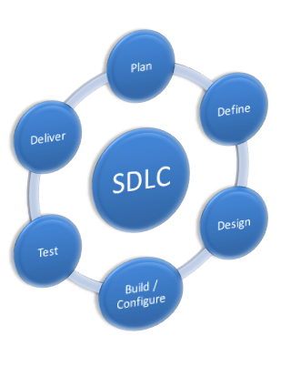
Work Procedure
Specification study
Study of the various practice of web development process
Study of the MVC framework and Codeigniter
Designed the database as per the requirement
Designed necessary modules
Developed the modules step by step
Testing

Slide 9
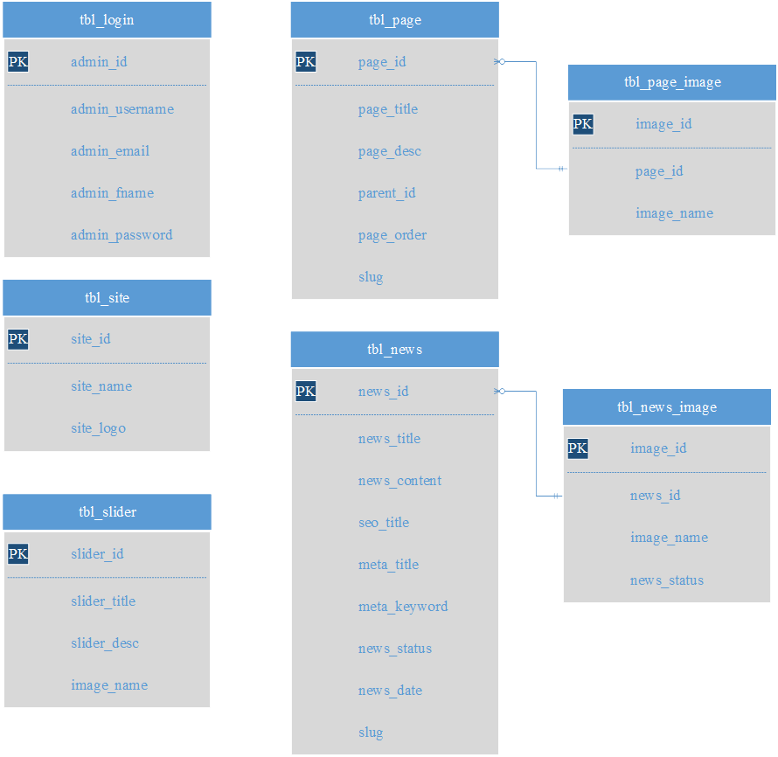
Database Tables for the System

Slide 10
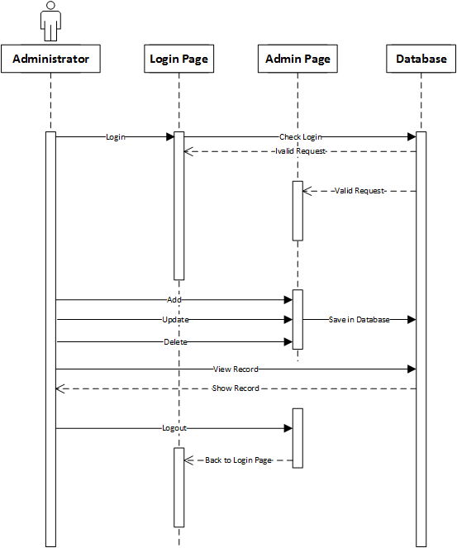
Sequence Diagram of the System

Slide 11
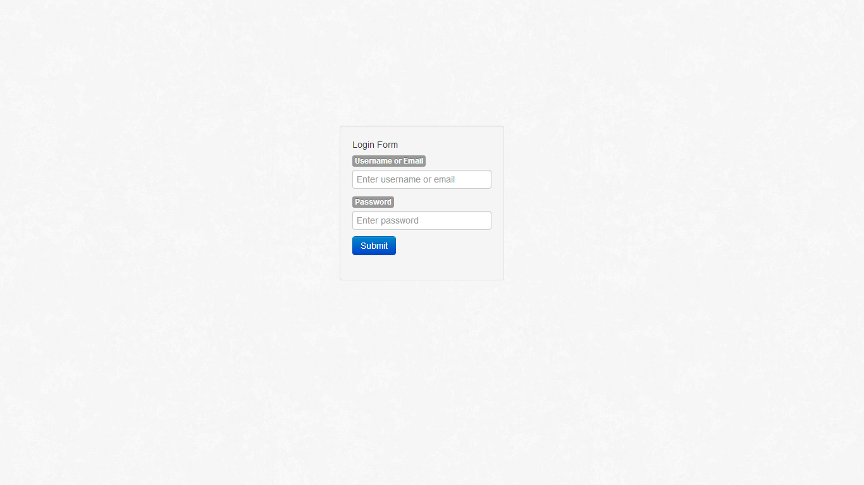
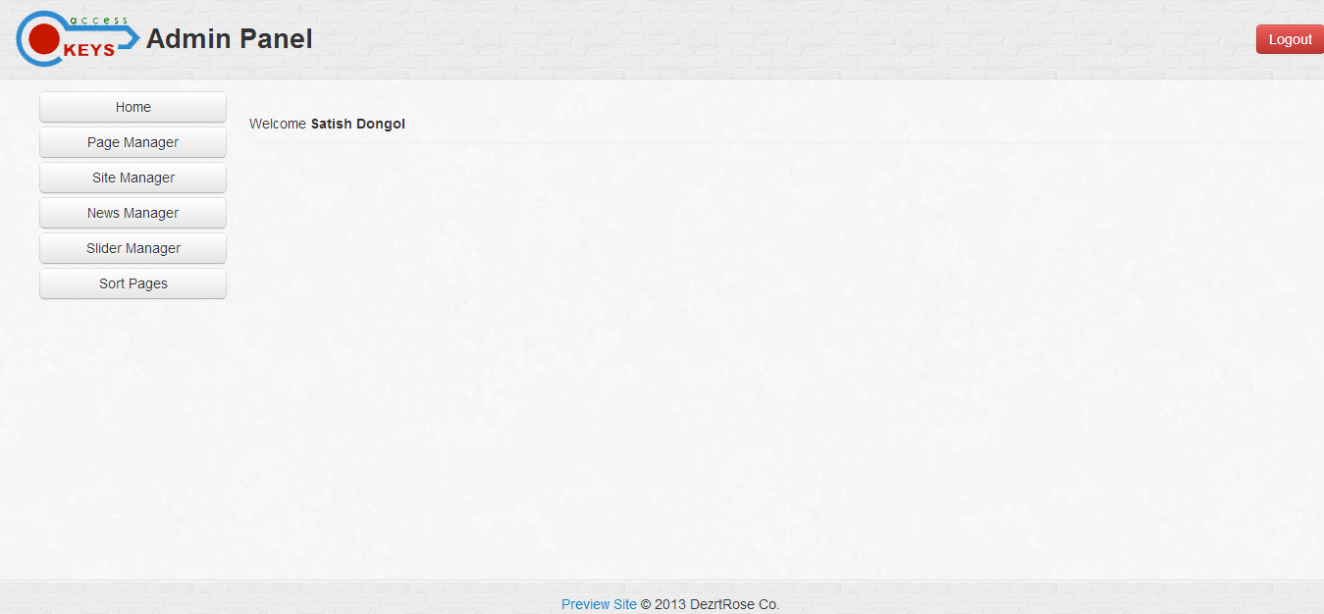
Few Screen Shots of the System
Login Success

Slide 12
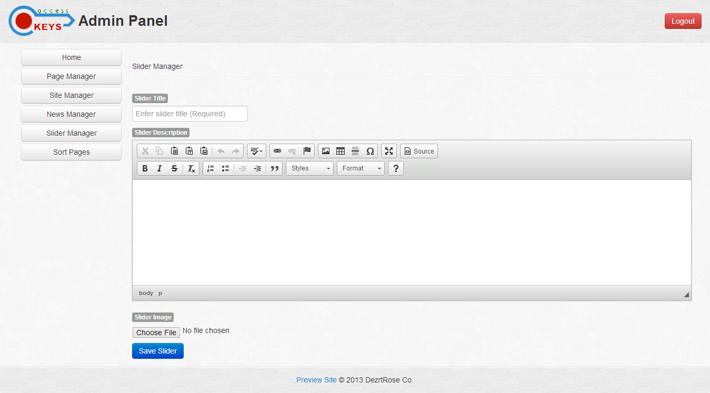
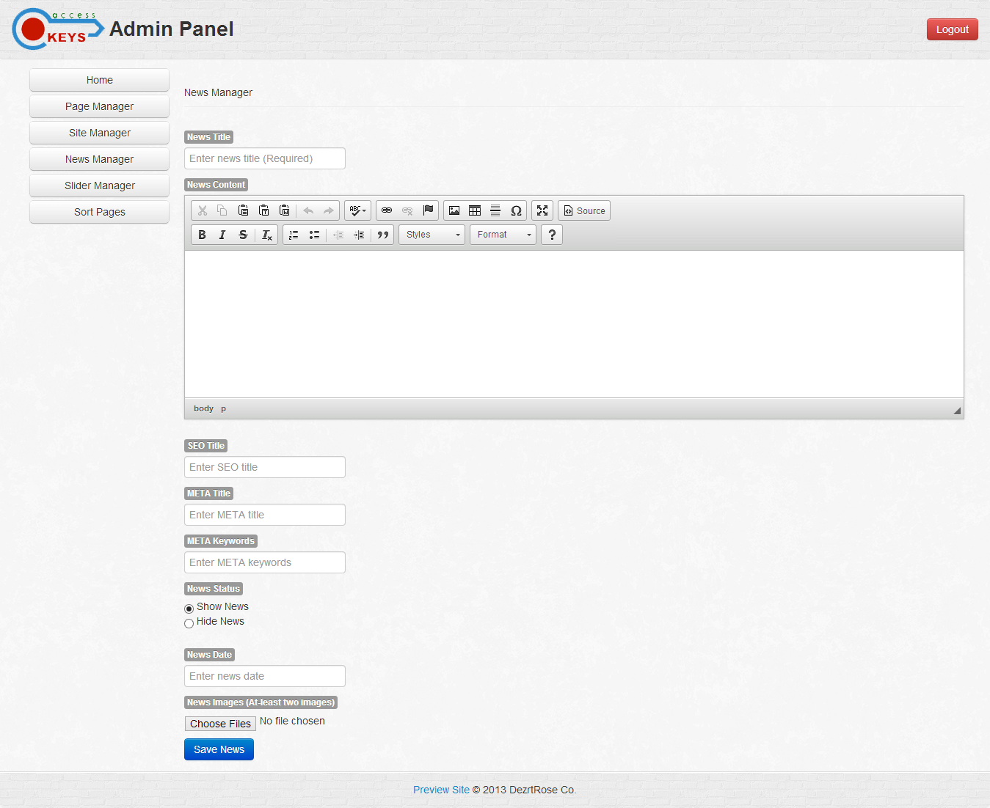
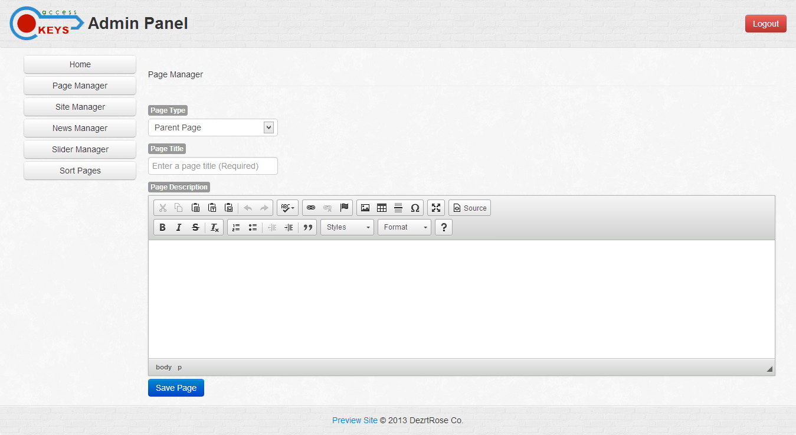

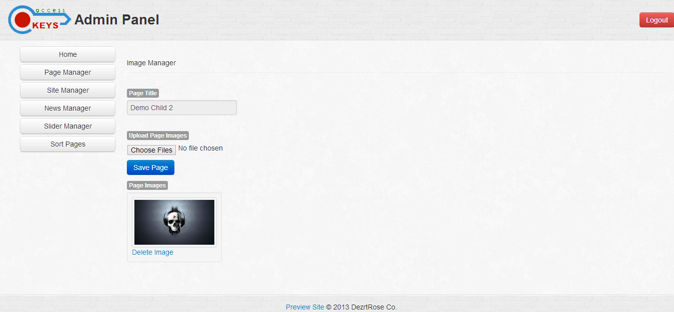
System View(contd…)
Add Slider
Add Page
Add News
Edit Page
Add Page Image

Slide 13
System View(contd…)
Logout Success

Slide 14

Conclusion
This internship project has taught me how to work in a professional environment
Learned how to handle deadline
Learned the procedure of web development and its new advances
Learned how to work in module basis
Learned to debug the errors in the web pages
Learned to handle people better and many more…

Slide 15
THANK YOU!!!!

